Slide 1
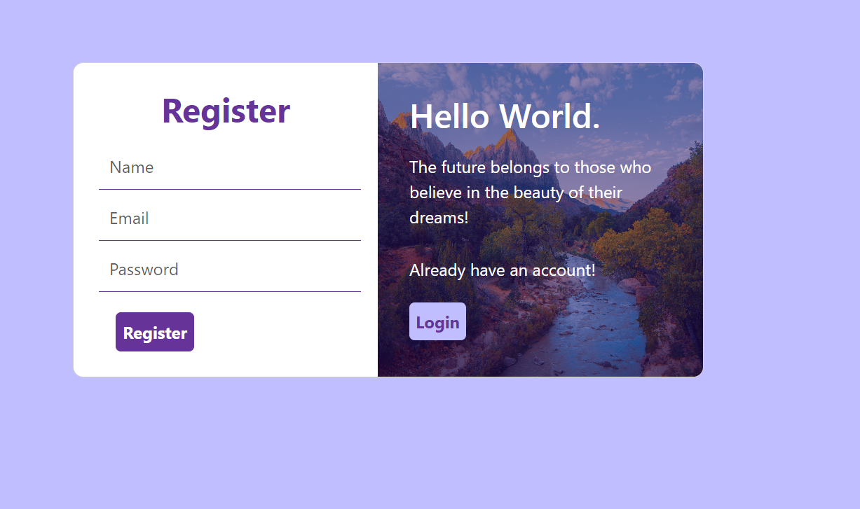
Login/Register Page

Slide 2
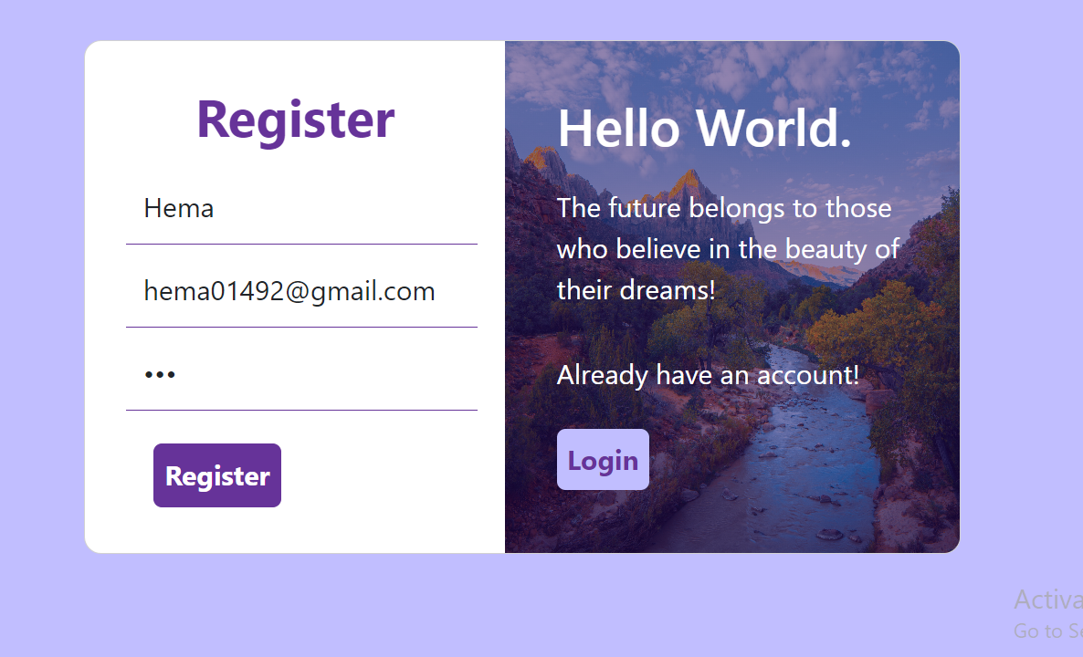
Register

Slide 3
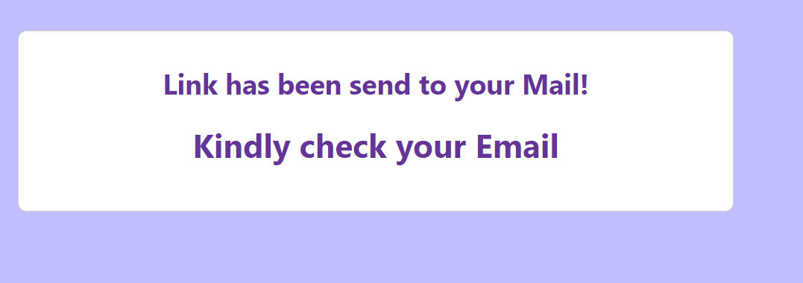
After Registered

Slide 4
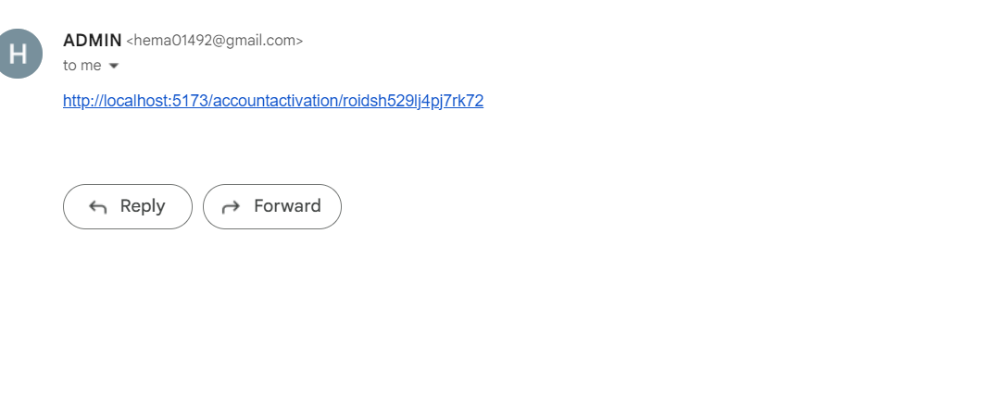
Getting Activation link

Slide 5
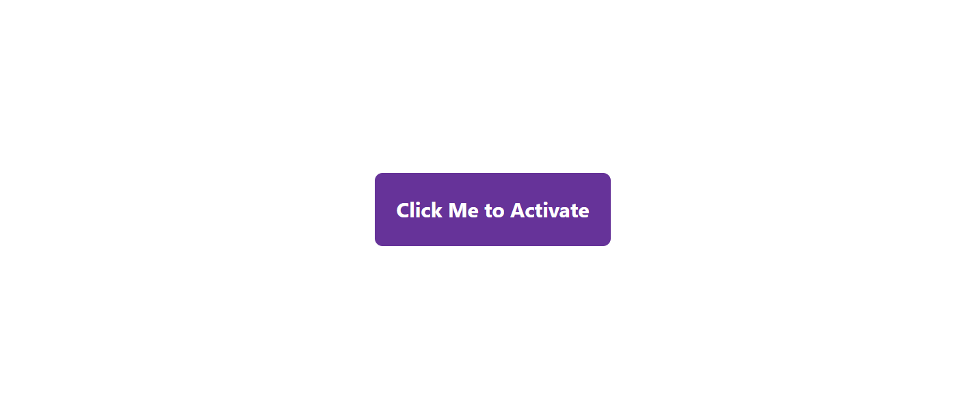
After Activation link clicked

Slide 6
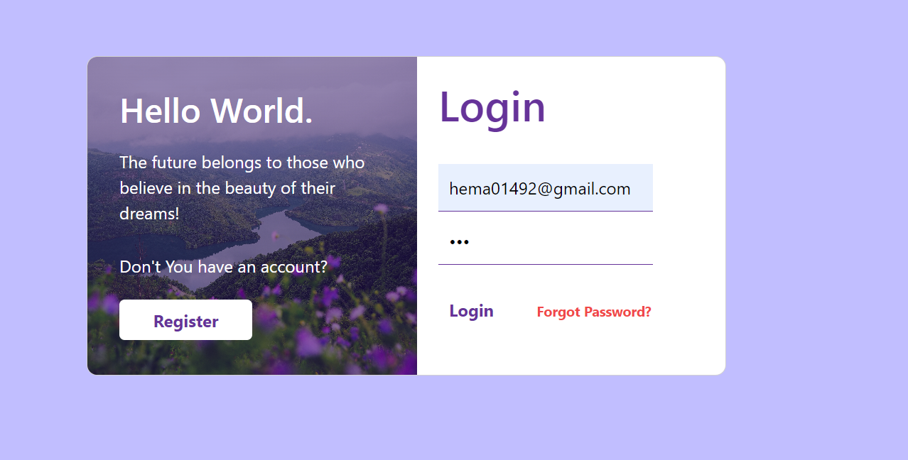
Login

Slide 7
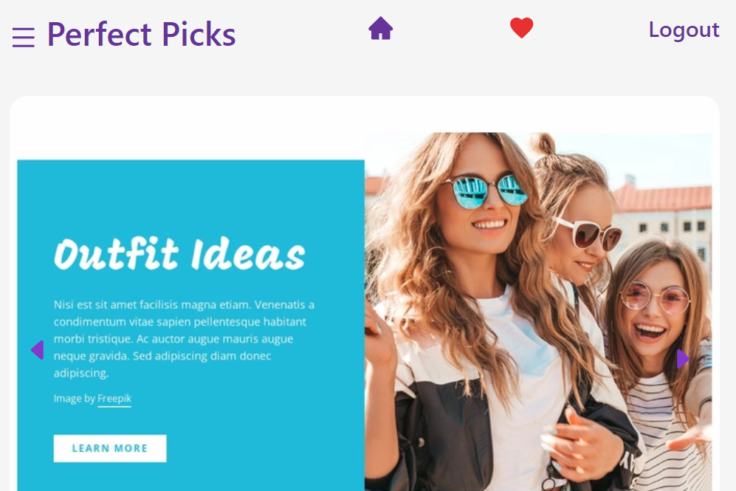
After Login Home Page

Slide 8
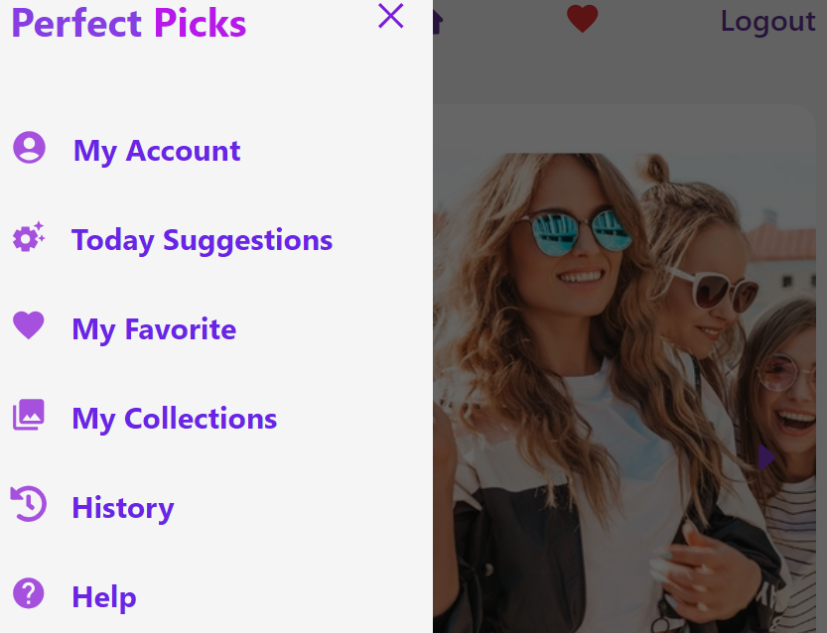
Side Bar/Menu

Slide 9
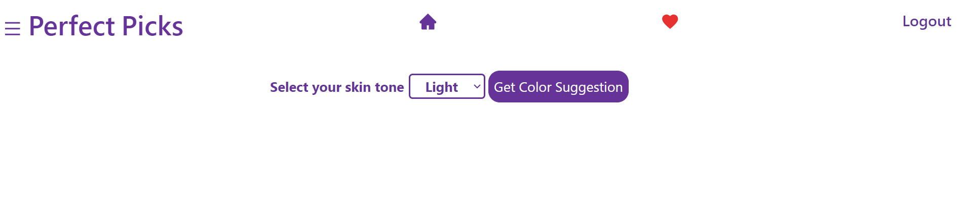
Click Today Suggestion select your skin tone and click get color suggestion

Slide 10
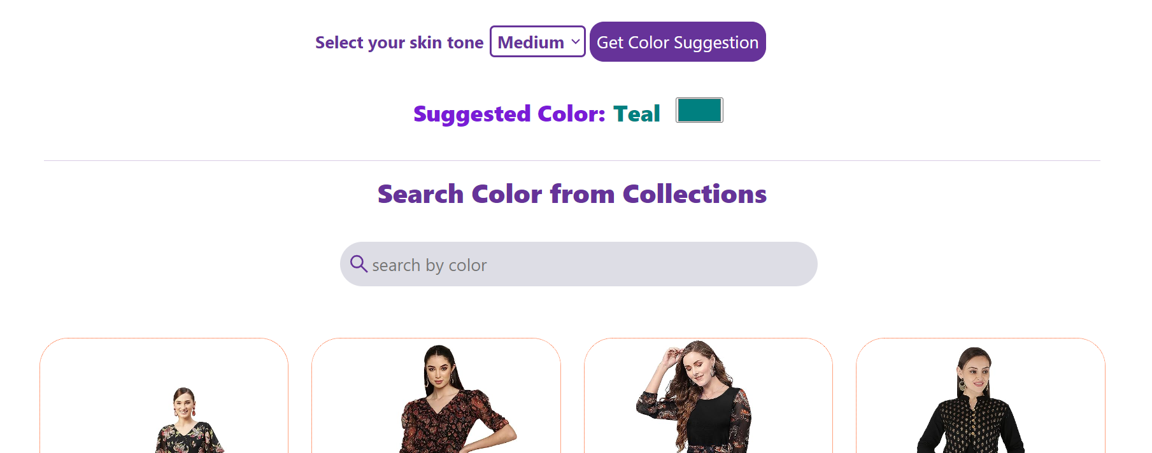
Color suggestion and our collection shown

Slide 11
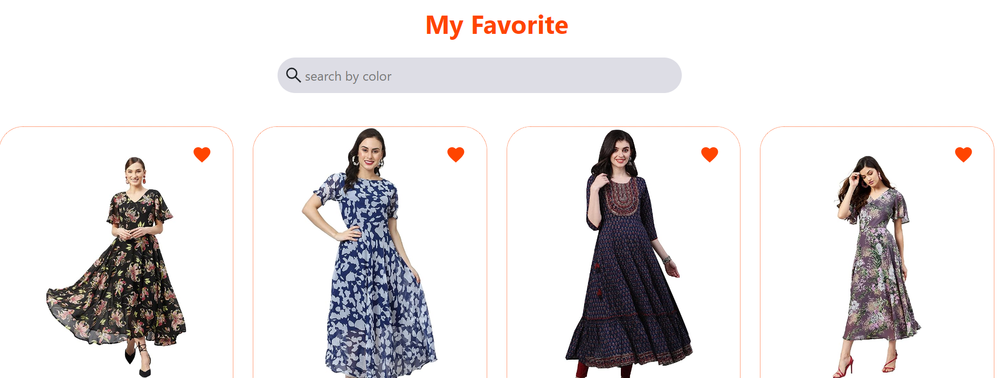
Click favorite button from side bar and view the favorite items from your collection

Slide 12
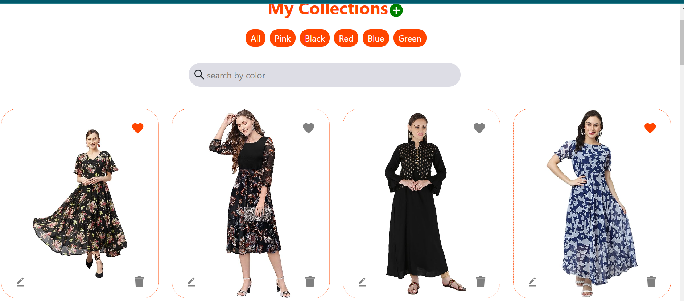
Click collection button from side bar and view the collection. Create, Edit ,Delete your collection as your wish

Slide 13
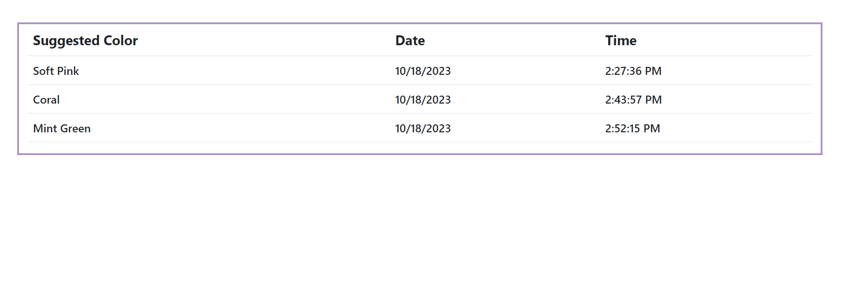
Click history to view previous suggestions

Slide 14
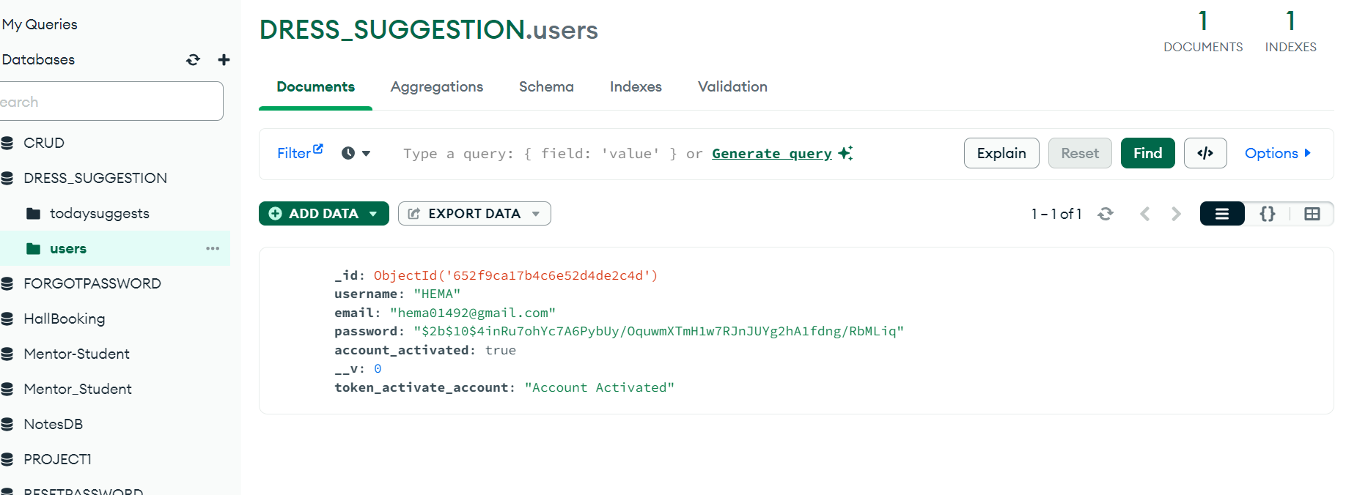
Mongo DB DATA

Slide 15
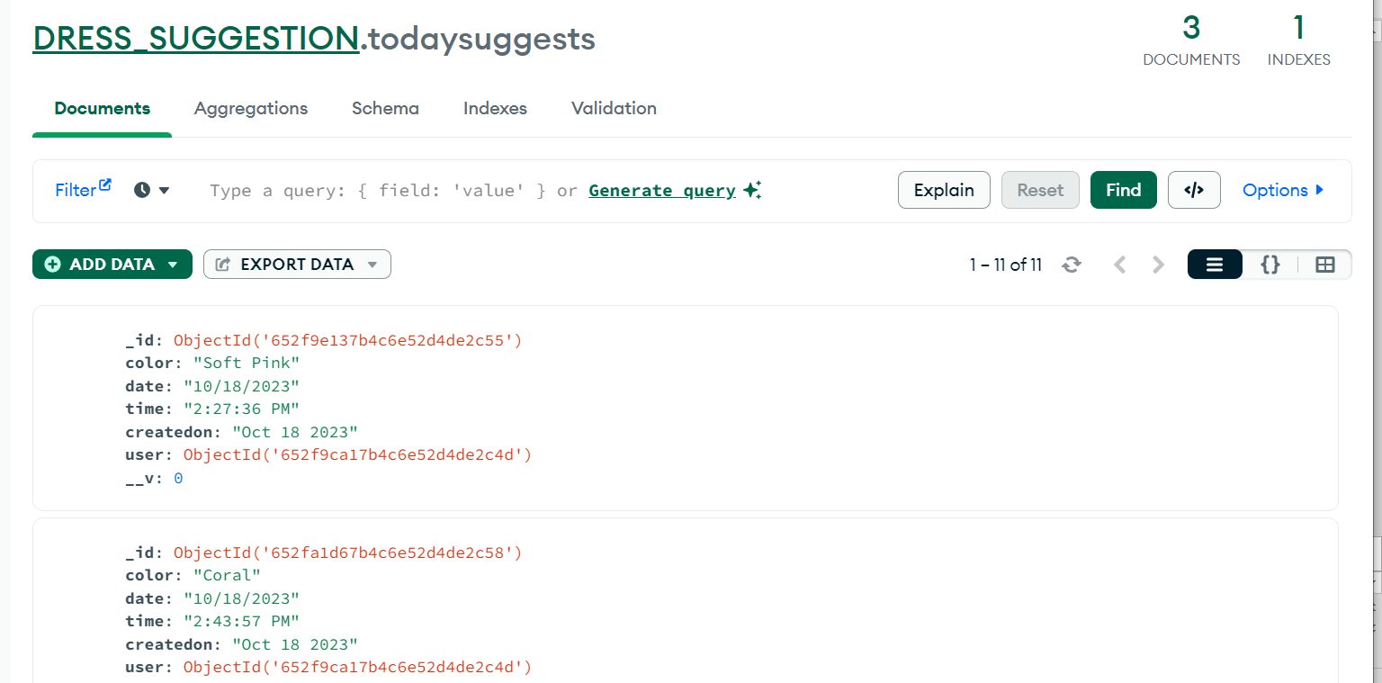
Color suggestion data

